Slide 1
Word of the Day: 10/20/2015
conundrum [kuh-nuhn-druhm]
PART OF SPEECH: noun
1. a riddle, the answer to which involves a punor play on words, as
2. anything that puzzles.
Example Sentence: The conundrum of job outsourcing is one that impacts many
companies in the United States.

Slide 2
Word of the Day: 10/21/2015
indignant /[in-dig-nuhnt]
Part of speech: adjective
feeling, characterized by, or expressing strong
displeasure at something considered unjust,
offensive, insulting, or base.
Example Sentence: The teen looked at his
mom with an indignant expression on his face.

Slide 3
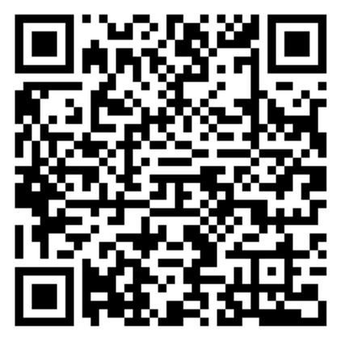
Word of the Day: 10/22/2015
benevolent
[buh-nev-uh-luhnt]
PART OF SPEECH: adjective
1. characterized by or expressing goodwill or kindly feelings
2. desiring to help others; charitable
3. intended for benefits rather than profit
Example Sentence: Gifts from several benevolent alumni made it possible to build the stadium.

Slide 4
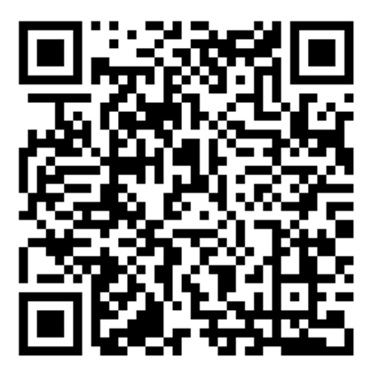
Word of the Day: 10/23/2015
punctilious [puhngk-til-ee-uhs]
PART OF SPEECH: adjective
extremely attentive to punctilios; strict or exact in the observance of the formalities or amenities of conduct or actions.
Example Sentence: The general required punctilious execution of his commands.

Slide 5
Word of the Day: 10/24/2015
euphemism
[yoo-fuh-miz-uhm]
PART OF SPEECH: noun
the substitution of a mild, indirect, or vague expression
for one thought to be offensive, harsh, or blunt.
2. the expression so substituted
Example Sentence: To ‘pass away’ is a euphemism for ‘to die’.

