Slide 1
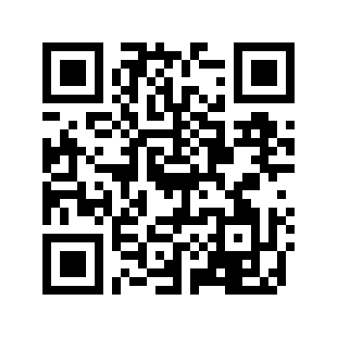
Word of the Day: 4/13/2015
gewgaw [gyoo-gaw, goo-] , noun
1. something gaudy and useless; trinket; bauble.
“Do you really need another gewgaw?”
Word selected using Dictionary.com: http://dictionary.reference.com/

Slide 2
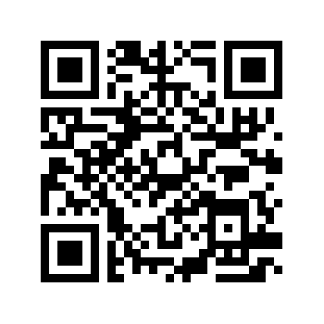
Word of the Day: 4/14/2015
itinerant [ahy-tin-er-uh nt, ih-tin-], adjective
1. traveling from place to place, especially on a circuit, as a minister, judge, or sales representative; journeying.
2. characterized by such traveling 3. working in one place for a comparatively short time and then moving on to work in another place, usually as a physical or outdoor laborer; characterized by alternating periods of working and wandering:
“The itinerant preacher journeyed across the country to spread his religion.” Word selected using Dictionary.com: http://dictionary.reference.com/

Slide 3
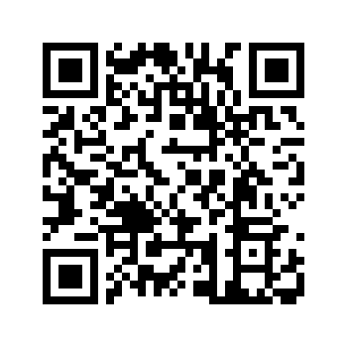
WOW Word Wednesday: 4/15/2015
empyrean [em-puh-ree-uh n, -pahy-, em-pir-ee-uh n, -pahy-ree-] , noun
1. the highest heaven, supposed by the ancients to contain the pure element of fire.
2. the visible heavens; the firmament.
In ancient times, Christians believed empyrean to be the abode of God and the angels. Word selected using Dictionary.com: http://dictionary.reference.com/

Slide 4
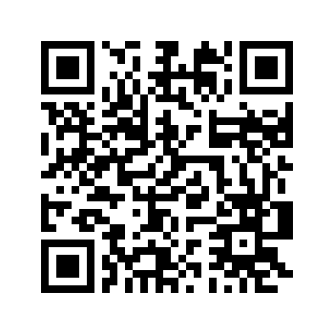
Word of the Day: 4/16/2015
propitious [pruh-pish-uh s], adj.
1.presenting favorable conditions; favorable
2. indicative of favor; auspicious:
3.favorably inclined; disposed to bestow favors or forgive
The timing for such a meeting seemed propitious.
Word selected using Dictionary.com: http://dictionary.reference.com/

Slide 5
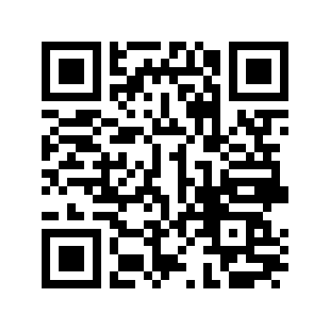
Word of the Day: 4/17/2015
slugabed [sluhg-uh-bed], noun
1. a lazy person who stays in bed long after the usual time for arising.
Many American teenagers are slugabeds during their summer vacation and sleep until noon. Word selected using Dictionary.com: http://dictionary.reference.com/

